Slide 1
Neanderthals

Slide 2
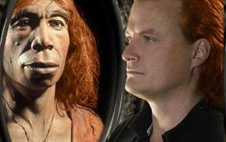
Neanderthals – how are they our cousins, but not our ancestors?

Slide 3
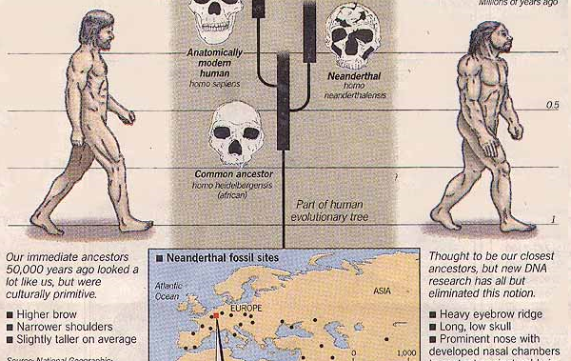
Neanderthals

Slide 4
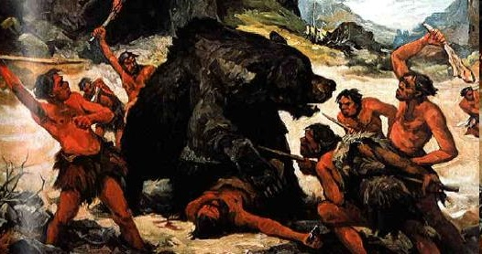
What sort of people were Neanderthals?

Slide 5
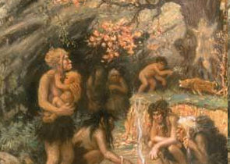
What sort of people were Neanderthals?

Slide 6
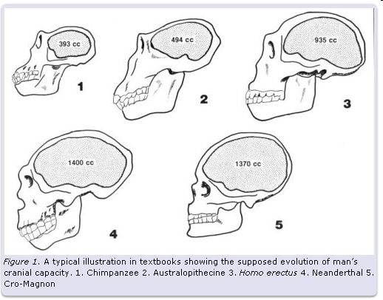
What do you notice about the data below?

Slide 7
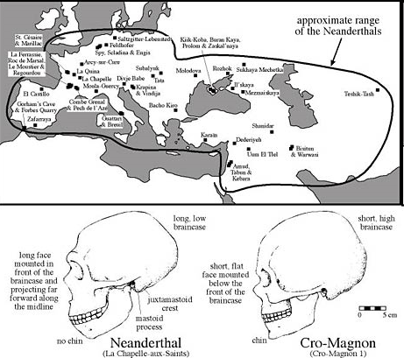

Slide 8
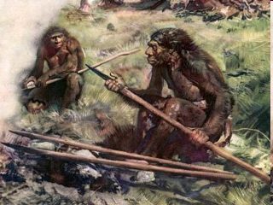
Four questions:
1 - What do you need to make a society? Did Neanderthals have one?

Slide 9
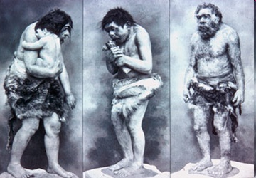
2 - What roles would each Neanderthal have?

Slide 10
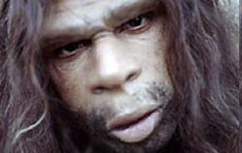
3 - What happened to the Neanderthal?

Slide 11
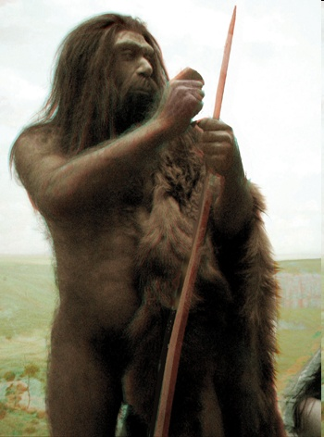
4 - Are we responsible for a Paleolithic genocide?

Slide 12
Neanderthal WebQuest

Slide 13
Quiz Time!

